Slide 1
Improving Quality of Experience for Machine Learning-Generated Dance Dance Revolution Beatmaps
Researcher: bradey Lounsbury
Advisor: Dr. Chad Mourning

Slide 2

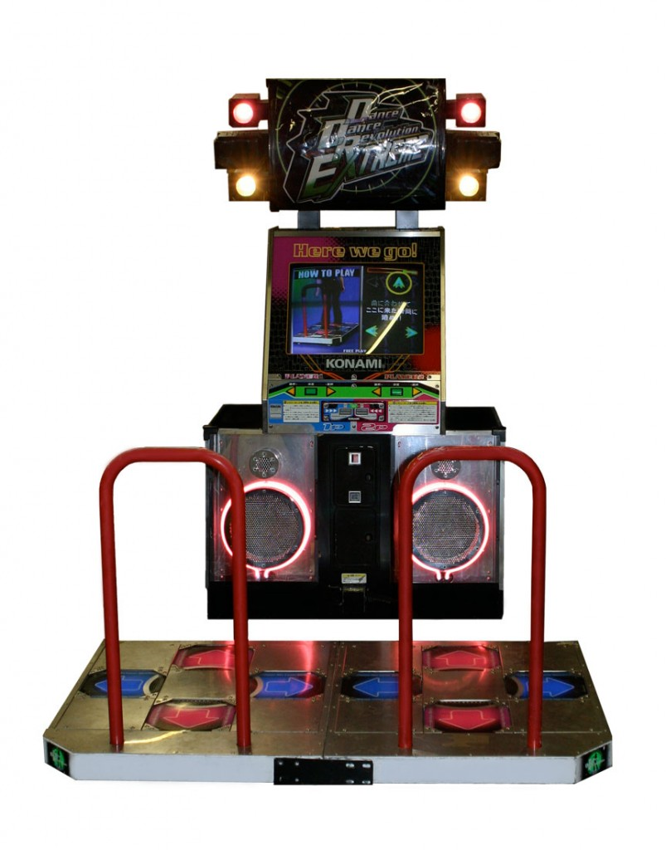
DDR
Dance Dance Revolution is a music video game involving patterns of steps that go along with a beat i.e., a beatmap.
These beatmaps mostly consist of matching steps to the beat of a song so why not try to generate them with ML model.

Slide 3
Enter Dance Dance Convolution
In 2017, Chris Donahue, Zachary Lipton, and Julian McAuley released a paper detailing a ML algorithm capable of generating a beatmap for any given song.
The algorithm consists of two models:
Step Placement
Step Selection
Link to paper: https://arxiv.org/pdf/1703.06891.pdf

Slide 4
How It Works
Extract features from a given audio file
Feed those features into a step placement algorithm
Find precise placements for steps using a peak-picking process
Feed placements found in 3. into a step selection algorithm to choose which kind of step goes in each placement

Slide 5
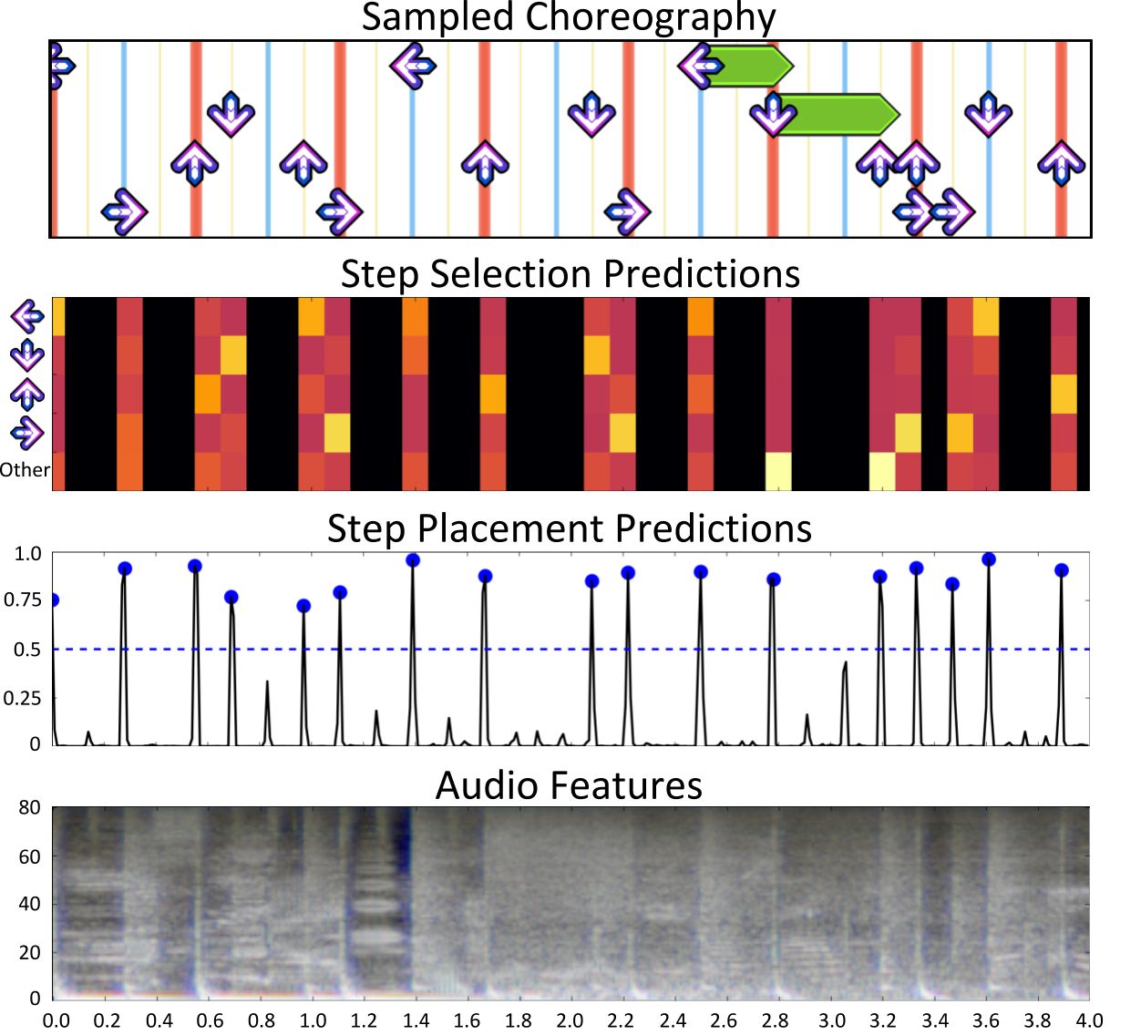
PIPELINE OF CURRENT ALGORITHM

Slide 6
What We Want To Do
Improve the beatmap generation algorithm
Why? Because the current algorithm struggles at beginner-intermediate difficulties
Test generated beatmaps against human curated beatmaps

Slide 7
How to Improve
Use a bigger dataset
The dataset used in the paper (Fraxtil) had less than 100 beatmaps
The dataset we’re using (Speirmix) has over 200 beatmaps
Use a GAN implementation instead
Current algorithm uses a LSTM model

Slide 8
How to Test
Maybe the current algorithm is already indistinguishable from human made beatmaps?
We can test this by having participants play a mix of generated and human curated beatmaps
After each song, the participant will rate five attributes:
Fun
Annoyance
Length
Naturalness
If they think the beatmap was made by a human or an ML algorithm

Slide 9
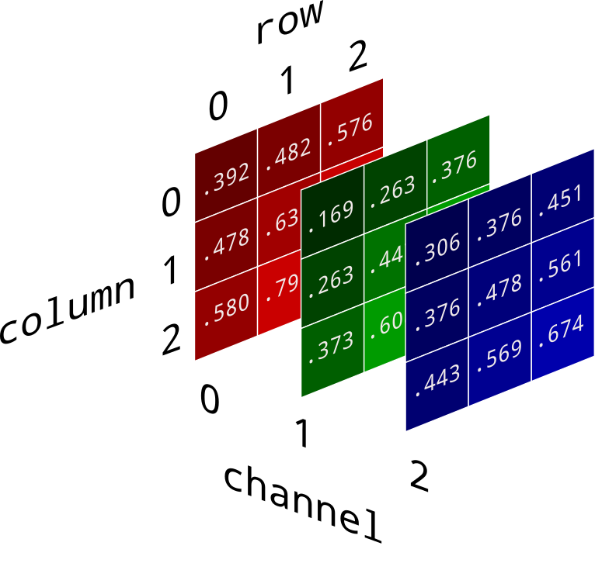
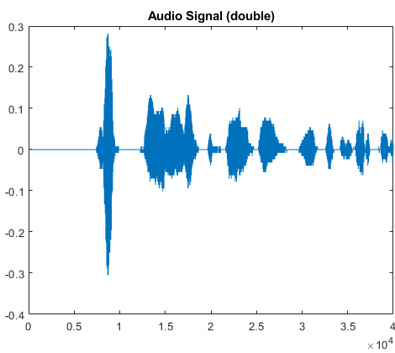
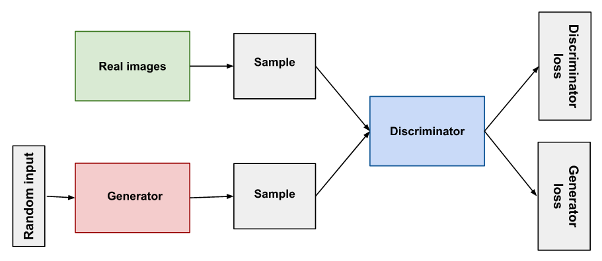
Why use GAN Implementation?
GANs are Generative Adversarial Networks
They currently only have one application, images
If we think of images as 2D arrays of data, then we can think of audio as 1D array of data
So why wouldn’t GANs work for audio as well

Slide 10
Future Work
Test the current algorithm’s quality of experience against human made beatmaps
Improve the algorithm by using a larger dataset
Provide a new application for GANs by implementing them in place of the current algorithm

